Slide 1
2024
Architecture Design
BUDGET SALES ANALYSIS
AMAN PRATAP SINGH

Slide 2
1 Architecture Design
Written By | AMAN PRATAP SINGH
Document Version | 1.0
Last Revised Date
DOCUMENT CONTROL
Change Record:
VERSION | DATE | AUTHOR | COMMENTS
Reviews:
VERSION | DATE | REVIEWER | COMMENTS
Approval Status:
VERSION | REVIEW DATE | REVIEWED BY | APPROWED BY | COMMENTS

Slide 3
2 Architecture Design
Table of Contents
1. Introduction ......................................................................................... 3
1.1 What is Architecture design document? ......................... 3 1.2 Scope ................................................................................................. 3 2. Architecture .......................................................................................... 4 2.1 Data source .................................................................................... 5 2.2 Data ingestion............................................................................... 5 2.3 Data warehouse ........................................................................... 6 2.4 BI semantic models .................................................................... 6 2.5 Report ............................................................................................... 7

Slide 4
3 Architecture Design
Introduction
What is Architecture design document?
Any software needs the architectural design to represents the design of
software. IEEE defines architectural design as “the process of defining a
collection of hardware and software components and their interfaces to establish the framework for the development of a computer system.” The software that is built for computer-based systems can exhibit one of these many architectures.
Each style will describe a system category that consists of:
A set of components (e.g., a database, computational modules) that will perform a function required by the system.
The set of connectors will help in coordination, communication, and cooperation between the components.
Conditions that how components can be integrated to form the
system.
Semantic models that help the designer to understand the overall
properties of the system.
1.2 Scope
Architecture Design Document (ADD) is an architecture design process that follows a step-by-step refinement process. The process can be used
for designing data structures, required software architecture, source code and ultimately, performance algorithms. Overall, the design principles may be defined during requirement analysis and then refined
during architectural design work.

Slide 5
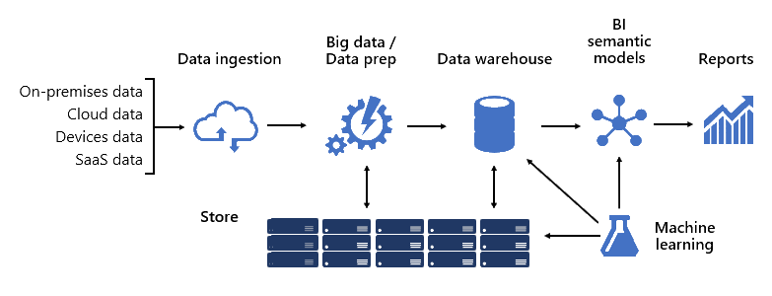
4 Architecture Design
2. Architecture
BI solution architecture can consist of:
Data sources
Data ingestion
Big data / data preparation
Data warehouse
BI semantic models
Reports

Slide 6
5 Architecture Design
Data source
A data warehouse can consolidate data which are commonly relational databases storing subject-specific data for sales,
marketing, finance, etc.
These databases can be cloud-hosted or they can reside on- premises.
Other data sources can be file-based, especially web logs or IOT data sourced from devices and data can be sourced from Software-as-a-Service (SaaS) vendors.
Data ingestion
Data is ingested from source systems and loaded into the data warehouse.
It is concerned with extracting, loading, and then transforming data.
The difference comes down to where the transformation takes place. Transformations are applied to cleanse, conform, integrate, and standardize data.

Slide 7
6 Architecture Design
Data warehouse
Sitting at the heart of a BI platform is the data warehouse, which hosts your enterprise models. It's a source of sanctioned data—as a system of record and as a hub—serving enterprise models for reporting, BI, and data science.
Many business services, including line-of-business (LOB) applications, can rely upon the data warehouse as an authoritative and governed source of enterprise knowledge.
BI semantic models
BI semantic models represent a semantic layer over enterprise models.
Business capabilities are enabled not by data alone, but by BI semantic models that describe concepts, relationships, rules, and standards.
This way, they represent intuitive and easy-to-understand structures that define data relationships and encapsulate business rules as calculations.
They can also enforce fine-grained data permissions, ensuring the right people have access to the right data. Importantly, they accelerate query performance, providing extremely responsive interactive analytics—even over terabytes of data.

Slide 8
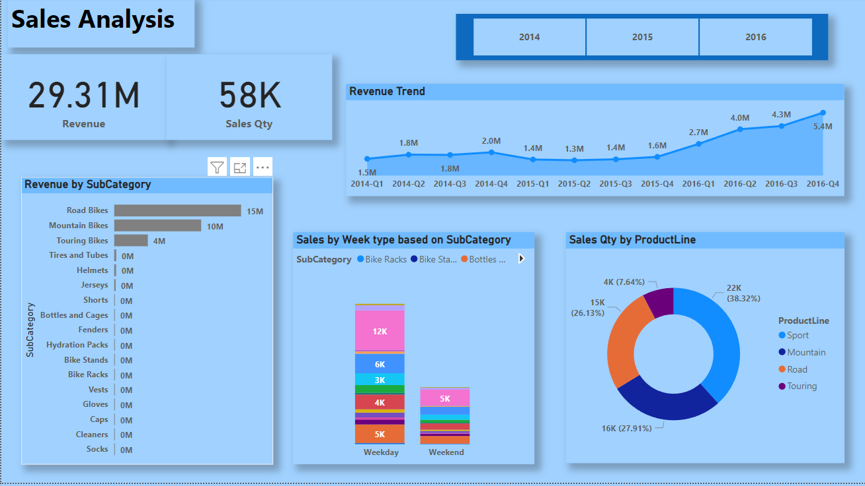
7 Architecture Design
2.5 Report
Power BI Report is a single page visualization to tell a story. The visualizations on a dashboard are generated from reports, and each report is based on one dataset.
Power BI allows you to create different reports on Power BI Desktop.
A Power BI report created on Power BI Desktop can be published on to Power BI Service by clicking on the Publish button.

